Slide 1
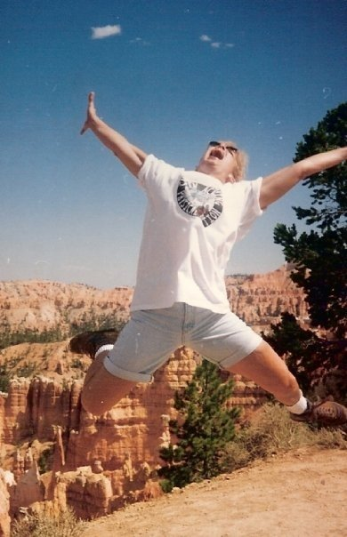
Divergent Discovery Unleashes the Creative – “Dance Free”
Department of Kinesiology
Health and Physical Education Teacher Certification Division
Dr. Fran Cleland
Coordinator of Health and Physical Education Teacher Certification Program

Slide 2
Frances E. Cleland Donnelly & Vicki Faden Millar (2019) Moving Green, Going Green: An Interdisciplinary Creative Dance Experience, Journal of Physical Education, Recreation & Dance, 90:8, 20-33, DOI: 10.1080/07303084.2019.1637304
Creative dance has been defined as a movement form through which students can express an idea, thought or feeling (Cone & Cone, 2012).
Creative dance fosters students’ ability to express and communicate their ideas, understand and know themselves and their world, and develop their movement skills (Cone & Cone, 2012).

Slide 3
DIVERGENT PRODUCTION - STYLE H
Purpose of Style: To engage students in discovering multiple responses to a given problem or question.

Slide 4
Teacher & Student Prerequisite Knowledge
Knowledge of the Movement Framework

Slide 5
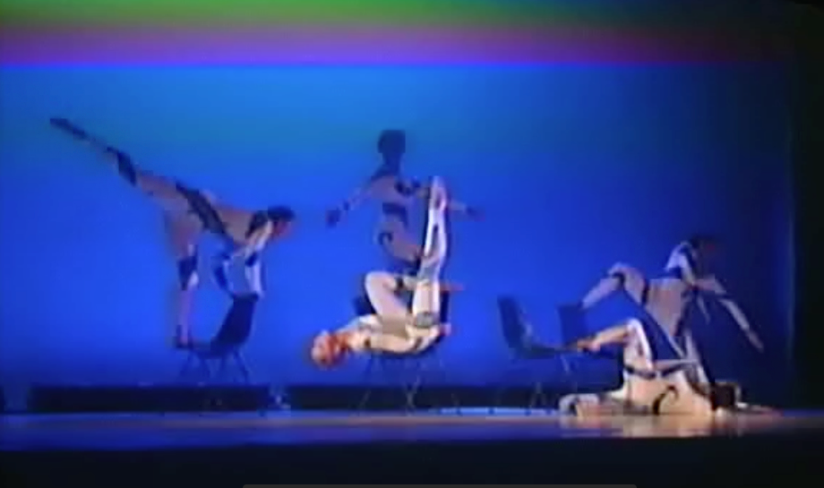

Slide 6
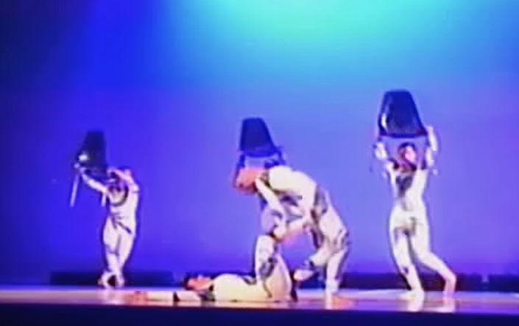

Slide 7
Your turn!
Create three different ways to sit in your chair
You may change the position of your chair
You can balance and make shapes an any body part you choose
Now perform your 3 chair positions

Slide 8
SEL Creative Dance Lesson 2022.docx

Slide 9
Moving Green Going Green

Slide 10
Boundary Ball Lesson Plan

